Slide 1
Entity framework Relational mapping
Entity framework mapping
OLEG LUCASH

Slide 2
Contents
Configuring relationships
Configuring One-to-Many relationship
Configuring many-to-Many relationship
Configuring one-to-one relationship
Cascade manipulations and Check constraints
Inheritance Strategy in Entity Framework
Handling concurrency conflicts
Code first migrations

Slide 3
Configuring relationships
To ensure these terms are clear:
The principal key refers to either the primary key or the new alternate key which has a unique value per row, which is not the primary key .
The foreign key holds the principal key value(s) of the database row it is linked to (or could be null).
The navigational property refers to the property that contain a single entity class, or collection of entity classes, which EF uses to link entity classes.
A principal entity is the entity that contains the principal key property(s) which the dependent relationship refers to via a foreign key(s).
A dependent entity is the entity that contains the foreign key property(s) which refers to the principal entity.
A required relationship is one where the foreign key is non-nullable, that is, the principal entity must exist.
An optional relationship is one where the foreign key is nullable, that is, the principal entity can be missing.

Slide 4
Configuring relationships

Slide 5
Configuring relationships
Relationship between tables is defined using foreign keys in relational database. The foreign key is a column or combination of columns which enforce relation between data of two tables. There are three types of relationships:
One to One
One to Many or Many to one
Many to Many
All three types of relationship is supported by Entity Framework

Slide 6
Configuring One-to-Many relationship

Slide 7
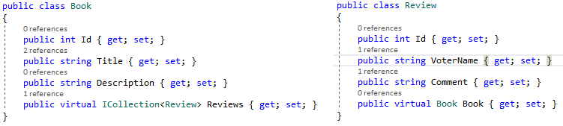
Configuring ONE-TO-MANY relationship using Default convention method
One to Many Relationships can be configured using Default Conventions, Data Annotations or Fluent API.
The easiest way to configure a one-to-many relationship is by convention. EF will create a relationship if an entity contains a navigation property.
Note that navigational property in the Review class returns the reference to the Book object. The navigational property in Book class returns the Reviews collection.

Slide 8
Foreign key Property
By default EF will look for the foreign key property with the same name as the principal entity primary key name.
If the foreign key property does not exist as in previous example, then EF will create a FK property using the convention – “<Navigation Property Name> + "_" + <Principal Key Name>. In our case it will be created Book_Id property.
You can include the foreign key property in the dependent class (Review). It will use existing property to create a relationship and it will create the foreign key column with the same name.
The are three options to create a foreign key referring to the Book using by convention method:

Slide 9
How EF finds foreign keys by convention

Slide 10
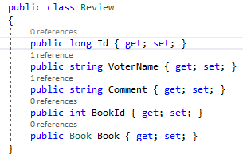
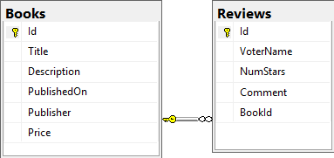
Foreign key Property
In our case we will use option 2. We include the foreign key property in the dependent class (Review). It will use existing property to create a relationship and it will create the foreign key column with the same name.

Slide 11
Nullability of foreign keys – required or optional relationships
Note that the BookId is created as Not Nullable column. If you want Nullable BookId column, then define the property as Nullable as shown in the example below
The nullability of the foreign key defines whether the relationship is required (non-nullable foreign key) or optional (nullable foreign key). A required relationship will ensure that relationships exist by ensuring the foreign key is linked to a valid principal key

Slide 12
When does the ‘by convention’ configuration not work?
When you have composite foreign keys
When you want to create a one-to-one relationship
When you want to override the default delete behavior setting
When you have two navigational properties going to the same class
If you want to define a specific database constraint

Slide 13
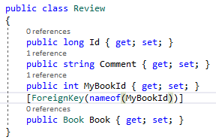
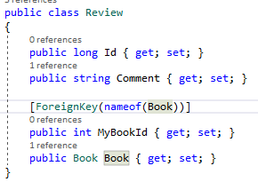
Configuring ONE-TO-MANY relationship using Data Annotations
The default convention makes an excellent work inferring the model and creates the necessary relationships. But the default conventions work only if you follow the conventions correctly.
There are only two Data Annotations that relate to relationships, as most of the navigational configuration is done via Fluent API. They are [ForeignKey] and [InverseProperty] annotations.

Slide 14
Configuring ONE-TO-MANY relationship using Data Annotations
The ForeignKey Data Annotation takes one parameter, which is a string. This should hold the name of the foreign key property. If the foreign key is a composite key, that is, it has more than one property, then these should be comma delimited, for instance,
[ForeignKey(“Property1, Property2”)].
About INVERSE attribute please study here:
http://www.entityframeworktutorial.net/code-first/inverseproperty-dataannotations-attribute-in-code-first.aspx

Slide 15
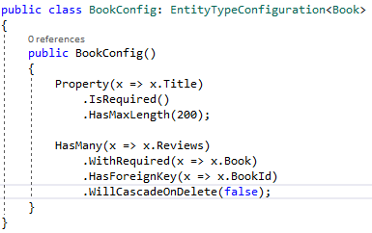
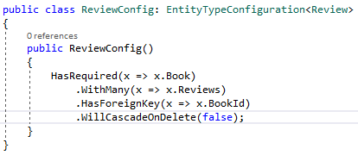
Creating a one-to-many relationship using Fluent api
Using “HasForeignKey” method we can define ForeignKey.
"HasRequired" or “WithRequired” method is used to make property non-nullable. Using these two methods of fluent API, we can define foreign key in code first.
“HasMany” method is used to define one-to-many relation in entity framework.
We can define one-to-many relationship using one of two methods.

Slide 16
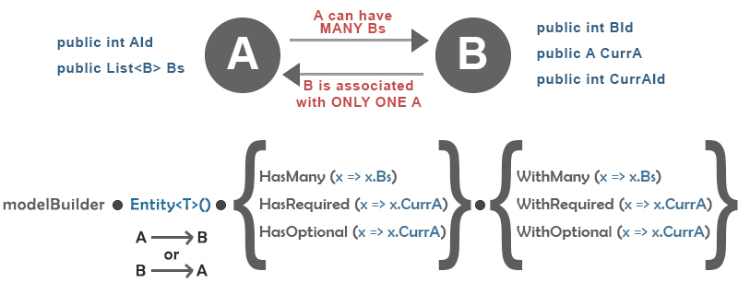
Creating a one-to-many relationship using Fluent api

Slide 17
Collections in configuration relationships
There are a couple of features about collections that are worth knowing about.
Firstly, you can use any generic type for a collection that implements the IEnumerable<T> interface, such as ICollection<T>, Collection<T>, List<T> and so on. IEnumerable<T> on its own is a special case, as you cannot add to that collection

Slide 18
Configuring many-to-Many relationship

Slide 19
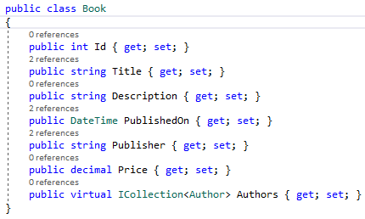
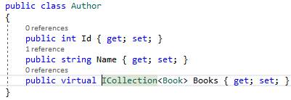
Configuring Many-TO-MANY relationship using By Convention approach
EF includes default conventions for many-to-many relationships. You need to include a collection navigation property at both ends.
EF API will create Books, Authors and also the joining table BookAuthors (the name of the both entities and the suffix 's') in the database for the above example. The BookAuthors table will include the PK (Primary Key) of both tables - Book_Id & Author_Id

Slide 20
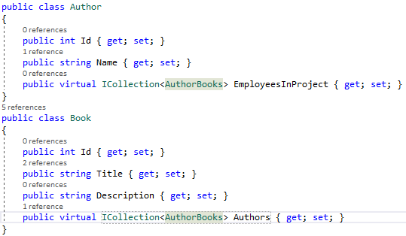
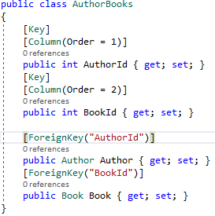
Configuring Many-TO-MANY relationship using Data annotations
The Many to Many Relationship Using Data Annotations requires you to create the Join Class.

Slide 21
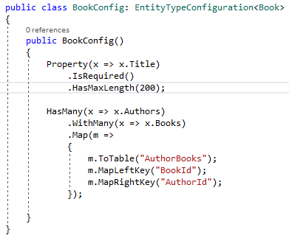
Configuring Many-TO-MANY relationship using fluent API
As you have seen, the default conventions for many-to-many relationships creates a joining table with the default naming conventions. Use Fluent API to customize a joining table name and column names, as shown below:

Slide 22
Configuring one-to-one relationship

Slide 23
Configuring one-TO-one relationship
There is one type of relationship that Code First will always require configuration for: one-to-one relationships. When you define a one-to-one relationship in your model, you use a reference navigation property in each class. If you have a reference and a collection, Code First can infer that the class with the reference is the dependent and should have the foreign key. If you have two collections, Code First knows it’s many-to-many and the foreign keys go in a separate join table. However, when Code First just sees two references, it can’t work out which class should have the foreign key.
One-to-one relationships are technically not possible in MS SQL Server. These will always be one-to-zero-or-one relationships. EF forms One-to-One relationships on entities not in the DB.
A one-to-zero-or-one relationship happens when a primary key of one table becomes PK & FK in another table in a relational database such as SQL Server.
EF does not support ONE-TO-ONE relationship with UNIQUE constraint. Such kind of relationship EF consider a ONE-TO-MANY relationship.

Slide 24
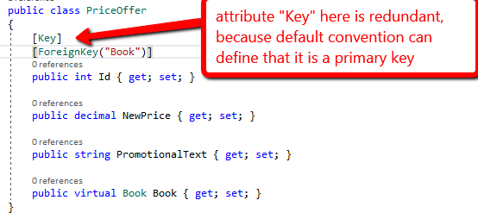
Configuring One-to-Zero-or-One relationship using data annotations
When configuring one-to-one relationships, Entity Framework requires that the primary key of the dependent also be the foreign key.
In our case PriceOffer is the dependent and its key - PriceOffer.Id should also be the foreign key. In Foreign Key attribute we should specify the name of navigation property for the relationship

Slide 25
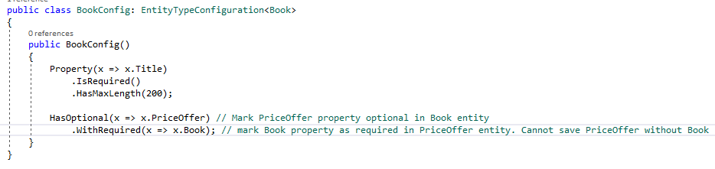
Configuring One-to-Zero-or-One relationship relationship using Fluent api
In order to configure relationship with the fluent API we should use the HasRequired, HasOptional methods. Also you can then configure an inverse navigation property by using the WithRequired, WithOptional
That’s actually enough for Code First to work out that PriceOffer is the dependent. Based on the multiplicity we specified, it only makes sense for Book to be the principal and PriceOffer to be the dependent, since a Book can exist without a PriceOffer but a PriceOffer must have a Book.

Slide 26

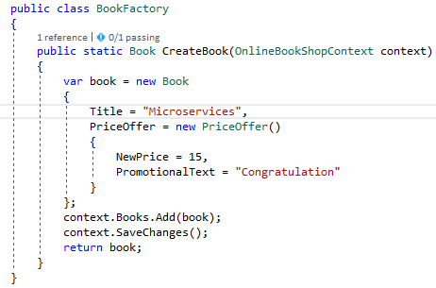
Configuring One-to-One relationship using data annotations
EF forms One-to-One relationships on entities not in the DB. We create One-to-One Relationships When Both Ends Are Required
Ensuring that Book is created with PriceOffer

Slide 27
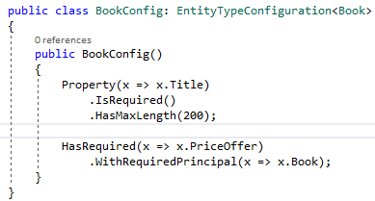
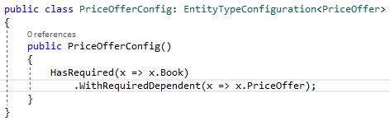
Configuring One-to-One relationship using Fluent api
When both ends of the relationship are required, use WithRequiredPrincipal or WithRequiredDependent after the HasRequired method.
WithRequiredPrincipal - The entity type being configured will be the principal in the relationship. The entity type that the relationship targets will be the dependent and contain a foreign key to the principal.
WithRequiredDependent - The entity type being configured will be the dependent and contain a foreign key to the principal. The entity type that the relationship targets will be the principal in the relationship.
In order to configure this kind of relationship you can use one of the 2 ways:

Slide 28
Cascade manipulations and Check constraints

Slide 29
Cascade manipulations
Relational databases need to keep referential integrity, so if we delete a row in a table that other rows are pointing to it via a foreign key then something has to happen to stop referential integrity being lost.
There are three ways that you can set a database can keep referential integrity when you delete a principal entity with dependent entities.
You can tell the database server to delete the dependent entities that rely on the principal entity – this is known as cascade deletes.
• You can tell database server can set the foreign keys of the dependent entities to null, if the column allows that.
If neither of those rules are set up, then the database server will raise an error if you try to delete a principal entity with dependent entities.

Slide 30
Cascade manipulations
Disable cascading:
public class BookConfig: EntityTypeConfiguration<Book>
{
public BookConfig()
{
HasMany(x => x.Reviews)
.WithRequired(x => x.Book)
.HasForeignKey(x => x.BookId)
.WillCascadeOnDelete(false);
}
}

Slide 31
Nullability of foreign keys
The required or optional status of the relationship also affects what happens when the principal entity is deleted. The default setting of the OnDelete action for each relationship type are as follows
For a required relationship, EF sets the OnDelete action to Cascade, that is, if the principal entity is deleted then the dependent entity will be deleted too.
For an optional relationship, EF sets the OnDelete action to ClientSetNull, that is, if the dependent entity is being tracked then the foreign key will be set to null when the principal entity is deleted. But if the dependent entity is NOT being tracked then the database settings take over, and that is set to Restrict, so the delete will fail in the database, and an exception will be thrown.

Slide 32
EF Mappings and Database constraints
Sometimes DB constraints cannot be created from mapping of an entity. For instance, you cannot add a column CHECK constraint such as Age int CHECK (Age>=18). For this level of control of the database, you need to use a script-based database schema change approach

Slide 33
Inheritance Strategy in Entity Framework

Slide 34
Inheritance in entity framework
Object-oriented techniques include "has a" and "is a" relationships, whereas SQL-based relational model has only a "has a" relationship between tables. SQL database management systems don't support type inheritance.
Below are three different approaches to represent an inheritance hierarchy:
Table per Hierarchy (TPH)
Table per Type (TPT)
Table per Concrete Class (TPC)

Slide 35
Mapping Hierarchies

Slide 36
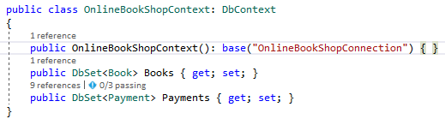
Table Per Hierarchy (TPH)
This approach suggests one table for the entire class inheritance hierarchy. The table includes a discriminator column which distinguishes between inheritance classes. This is a default inheritance mapping strategy in Entity Framework.
Columns for Properties that are not shared across all types need to be nullable, even if they aren't nullable properties. Which means the database is not completely enforcing your null-ability constraints.
Supports polymorphic association

Slide 37
Polymorphic query in tph
Polymorphic query — is query for instances of a class and all instances of its subclasses
SELECT
[Extent1].[Discriminator] AS [Discriminator],
[Extent1].[Id] AS [Id],
[Extent1].[Amount] AS [Amount],
[Extent1].[ReceiptCode] AS [ReceiptCode],
[Extent1].[NumberOfBills] AS [NumberOfBills]
FROM [dbo].[Payments] AS [Extent1]
WHERE [Extent1].[Discriminator] IN (N'PaymentCard',N'PaymentCash')
[TestMethod]
public void PolymorphicQuery()
{
var query = ShopContext.Payments.ToList();
}

Slide 38
Non-polymorphic query in tph
Non-polymorphic query is query whose polymorphism is restricted and only returns instances of a particular subclass.
SELECT
'0X0X' AS [C1],
[Extent1].[Id] AS [Id],
[Extent1].[Amount] AS [Amount],
[Extent1].[ReceiptCode] AS [ReceiptCode]
FROM [dbo].[Payments] AS [Extent1]
WHERE [Extent1].[Discriminator] = N'PaymentCard'
[TestMethod]
public void NonPolymorphicQuery()
{
var query = ShopContext.Payments.OfType<PaymentCard>().ToList();
}

Slide 39
Polymorphic association
A polymorphic association is an association to a base class, hence to all classes in the hierarchy with dynamic resolution of the concrete class at runtime.
public class User
{
public int Id { get; set; }
public string FirstName { get; set; }
public string LastName { get; set; }
public int PaymentId { get; set; }
public virtual Payment Payment { get; set; }
}
public static User CreateUser(OnlineBookShopContext shopContext)
{
var user = new User()
{
FirstName = "Jon",
LastName = "Doe",
Payment = new PaymentCard()
{
Amount = 90,
ReceiptCode = "BCFEQ2"
}
};
shopContext.Users.Add(user);
shopContext.SaveChanges();
return user;
}

Slide 40
Table per Type (TPT)
Every class/subclass that declares persistent properties—including abstract classes—has its own table.
The table for subclasses contains columns only for each non inherited property (each property declared by the subclass itself) along with a primary key that is also a foreign key of the base class table.
Supports polymorphic association

Slide 41
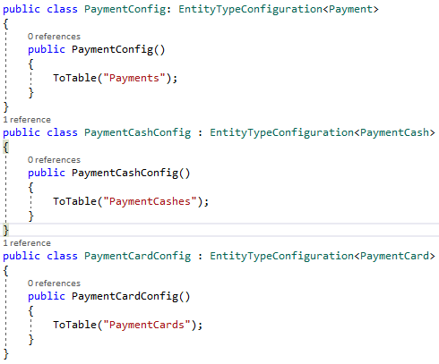
Table Per Type(TPT) - example

Slide 42
Polymorphic query in Table Per Type
public void PolymorphicQuery()
{
var query = ShopContext.Payments.ToList();
}
SELECT
CASE WHEN ([UnionAll1].[C2] = 1) THEN '0X0X' ELSE '0X1X' END AS [C1],
[UnionAll1].[Id] AS [C2],
[Extent3].[Amount] AS [Amount],
CASE WHEN ([UnionAll1].[C2] = 1) THEN [UnionAll1].[ReceiptCode] END AS [C3],
CASE WHEN ([UnionAll1].[C2] = 1) THEN CAST(NULL AS int) ELSE [UnionAll1].[C1] END AS [C4]
FROM (SELECT
[Extent1].[Id] AS [Id],
[Extent1].[ReceiptCode] AS [ReceiptCode],
CAST(NULL AS int) AS [C1],
cast(1 as bit) AS [C2]
FROM [dbo].[PaymentCards] AS [Extent1]
UNION ALL
SELECT
[Extent2].[Id] AS [Id],
CAST(NULL AS varchar(1)) AS [C1],
[Extent2].[NumberOfBills] AS [NumberOfBills],
cast(0 as bit) AS [C2]
FROM [dbo].[PaymentCashes] AS [Extent2]) AS [UnionAll1]
INNER JOIN [dbo].[Payments] AS [Extent3] ON [UnionAll1].[Id] = [Extent3].[Id]

Slide 43
Non-polymorphic query in Table Per type
SELECT
'0X0X' AS [C1],
[Extent1].[Id] AS [Id],
[Extent2].[Amount] AS [Amount],
[Extent1].[ReceiptCode] AS [ReceiptCode]
FROM [dbo].[PaymentCards] AS [Extent1]
INNER JOIN [dbo].[Payments] AS [Extent2] ON [Extent1].[Id] = [Extent2].[Id]
public void NonPolymorphicQuery()
{
var query = ShopContext.Payments.OfType<PaymentCard>().ToList();
}

Slide 44
Table per Concrete Class (TPC)
This approach suggests one table for one concrete class, but not for the abstract class. So, if you inherit the abstract class in multiple concrete classes, then the properties of the abstract class will be part of each table of the concrete class.
There is no relationship between the database tables, except for the fact that they share some similar columns.
Just like the TPT implementation, we need to specify a separate table for each of the subclasses. We also need to tell that we want all of the inherited properties to be mapped as part of this table.

Slide 45
Table per Concrete Class (TPC)
All hierarchy should have unique primary key.
SQL Server’s int identity columns doesn't work very well together with TPC since there will be duplicate entity keys when inserting in subclasses tables
Using GUID keys, or int identity keys with different starting seeds will solve the problem but yet another solution would be to completely switch off identity on the primary key property.
We need to take the responsibility of providing unique keys when inserting records to the database
Does not support polymorphic association. Associations are represented as foreign key relationships. If User has a many-to-one relationship with Payments, the Users table would need a single foreign key column, which would have to refer both concrete subclass tables. This isn’t possible with regular foreign key constraints.

Slide 46
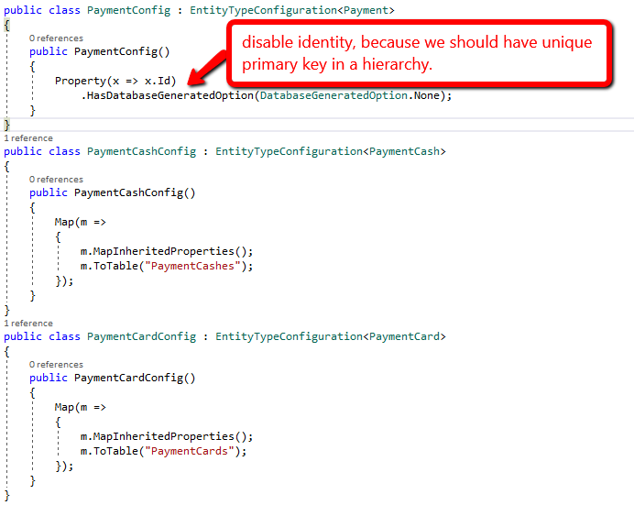
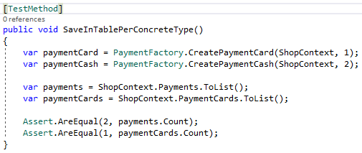
Table per Concrete Class (TPC)

Slide 47
Polymorphic query in Table Per Concrete class
public void PolymorphicQuery()
{
var query = ShopContext.Payments.ToList();
}
SELECT
CASE WHEN ([UnionAll1].[C2] = 1) THEN '0X0X' ELSE '0X1X' END AS [C1],
[UnionAll1].[Id] AS [C2],
[UnionAll1].[Amount] AS [C3],
CASE WHEN ([UnionAll1].[C2] = 1) THEN [UnionAll1].[C1] END AS [C4],
CASE WHEN ([UnionAll1].[C2] = 1) THEN CAST(NULL AS int) ELSE [UnionAll1].[NumberOfBills] END AS [C5]
FROM (SELECT
[Extent1].[Id] AS [Id],
[Extent1].[Amount] AS [Amount],
CAST(NULL AS varchar(1)) AS [C1],
[Extent1].[NumberOfBills] AS [NumberOfBills],
cast(0 as bit) AS [C2]
FROM [dbo].[PaymentCashes] AS [Extent1]
UNION ALL
SELECT
[Extent2].[Id] AS [Id],
[Extent2].[Amount] AS [Amount],
[Extent2].[ReceiptCode] AS [ReceiptCode],
CAST(NULL AS int) AS [C1],
cast(1 as bit) AS [C2]
FROM [dbo].[PaymentCards] AS [Extent2]) AS [UnionAll1]

Slide 48
Non-polymorphic query in Table Per Concrete class
SELECT
'0X0X' AS [C1],
[Extent1].[Id] AS [Id],
[Extent1].[Amount] AS [Amount],
[Extent1].[ReceiptCode] AS [ReceiptCode]
FROM [dbo].[PaymentCards] AS [Extent1]
public void NonPolymorphicQuery()
{
var query = ShopContext.Payments.OfType<PaymentCard>().ToList();
}

Slide 49
Which strategy is the best?
While TPC in the EF forces you to avoid polymorphic associations in your base type. Because of these issues we generally discourage the use of TPC with the Entity Framework. Also in most cases we should care about generating primary key. This means in most situations the question comes down to TPH or TPT?
Сoncern | Winner | Reasoning
Performance | TPH | Table Per Hierarchy is generally better performing, because no joins are necessary, everything is in one table. The decision becomes even more clear cut once the inheritance hierarchy gets wide or deep.
Flexibility | TPT | Table Per Type allows customizations without modifying the 'base' table. I.e. new subtypes can be added simply by creating new tables for those sub-types.
Database Validation | TPT | TPH requires columns in derived types to be NULLABLE in the database, so that other derived types can be stored in the same table. Because of this it is possible to create rows in the table that are not valid according to the conceptual model. I.e. the column is NULLABLE but the combination of a particular column being NULL and a particular discriminator or type is not valid. This means the database is not enforcing the conceptual model for you anymore. This is fine if all access to the database is via the EF, but if anything else is used, you can end up with 'dirty' data.
Aesthetics | TPT | This one is completely subjective, but TPT feels more Object Oriented
Storage Space | TPT | If your inheritance hierarchy has lots of types, then using TPH will result in lots of empty cells. If your database can handle 'sparse' columns well this probably isn't a real concern.

Slide 50
Handling concurrency conflicts

Slide 51
Handling concurrency conflicts
A concurrency conflict occurs when one user displays an entity's data in order to edit it, and then another user updates the same entity's data before the first user's change is written to the database. If you don't enable the detection of such conflicts, whoever updates the database last overwrites the other user's changes.
In many applications, this risk is acceptable: if there are few users, or few updates, or if isn't really critical if some changes are overwritten, the cost of programming for concurrency might outweigh the benefit.

Slide 52
Handling concurrency conflicts
EF concurrency conflict handling features consist of two ways that EF can detect a concurrency update. These are activated by adding one of the following to an entity class.
A concurrency token, to mark a specific property/column in your entity class as one to check for a concurrency conflict.
A timestamp, which marks a whole entity class/row as one to check for a concurrency conflict.

Slide 53
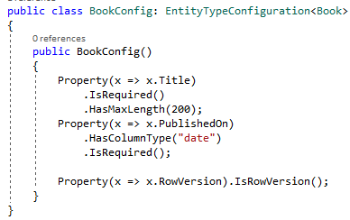
DETECTING A CONCURRENT CHANGE VIA TIMESTAMP or rowversion
public class Book
{
public int Id { get; set; }
public string Title { get; set; }
public string Description { get; set; }
public DateTime PublishedOn { get; set; }
public byte[] RowVersion { get; set; }
}
exec sp_executesql N'UPDATE [dbo].[Books]
SET [Title] = @0
WHERE (([Id] = @1) AND ([RowVersion] = @2))
SELECT [RowVersion]
FROM [dbo].[Books]
WHERE @@ROWCOUNT > 0 AND [Id] = @1',N'@0 nvarchar(200),@1 int,@2 binary(8)',@0=N'Banana',@1=4,@2=0x00000000000007DD

Slide 54
Code first migrations

Slide 55
Code first migrations
Entity Framework Code-First had different database initialization strategies like CreateDatabaseIfNotExists, DropCreateDatabaseIfModelChanges, and DropCreateDatabaseAlways. However, there are some problems with these strategies, for example if you already have data (other than seed data) or existing Stored Procedures, triggers etc. in your database. These strategies used to drop the entire database and recreate it, so you would lose the data and other DB objects
Entity Framework introduced a migration tool that automatically updates the database schema when your model changes without losing any existing data or other database objects.
EF includes a new Code First Migrations feature that allows you to incrementally evolve the database schema as your model changes over time.

Slide 56
Code first migrations
There are two kinds of Migration:
Automated Migration
Code-based Migration
http://www.entityframeworktutorial.net/code-first/automated-migration-in-code-first.aspx
http://www.entityframeworktutorial.net/code-first/code-based-migration-in-code-first.aspx

Slide 57
Assignment
Study all material
Add and configure collections In your domain
Pay attention to cascade
Try cascade save, update, delete.
Try at least two ways of mapping Hierarchies
Try to Handle concurrency conflicts

Slide 58
References
https://weblogs.asp.net/manavi/inheritance-mapping-strategies-with-entity-framework-code-first-ctp5-part-1-table-per-hierarchy-tph
https://blogs.msdn.microsoft.com/alexj/2009/04/14/tip-12-how-to-choose-an-inheritance-strategy/
http://www.entityframeworktutorial.net/code-first/automated-migration-in-code-first.aspx
http://www.entityframeworktutorial.net/code-first/code-based-migration-in-code-first.aspx

Slide 59
Revisions
Number | Author | Date | Description
1.0.0 | Oleg Lucash | 03.03.2018 | Initial version

